Slide 1
How Education Could Affect Career Success
DSO-510 Final Project
‘Chris’ Jooyoung Cho, Shao Xuan Chew, Jiaming Pei, ‘Jessica’ Ziyue Wang,
‘Robert’ Xu Zhu, ‘Samuel’ Delin Zhu

Slide 2
Project Summary and Introduction
In this project, we evaluate the impact of education on career success using salary as a proxy. Specifically, we research how the relevancy of one's education field and education level affect their salary.
Dependent Variable: "Salary" (Monthly Income)
As a proxy of measuring career success and workplace progression.
Independent variable: "Education":
1) Different education levels’ impact on individual’s career success. Would a higher-level degree lead to a higher salary?
2) Relevance of education background with the employee's job role. Would having an education in a relevant field lead to better salary?

Slide 3
Why is this question Important?
Education is commonly considered as a key factor when determining the personal attainment of a candidate or employee. Job roles typically prefer or even require specific education levels or fields of study, yet we lack empirical evidence to understand the true impact education has on career success.
With the dataset containing employee’s background and their compensation information in the company, we are able to utilize linear regression to create an explanatory model to understand the relationship between education (level and match) and career success within the scope of the data.

Slide 4
Academic Evidence & Hypothesis
A survey by Georgetown Center on Education and Workforce showed that earning generally increase with more education, although some workers with less education can earn more than others with more education, due to the substantial variations in earning within education levels. (Carnevale et al. 2021)
Employees who are mismatched with employment and education background generally incur a wage penalty. Robst (2007) showed that whereas mismatched men and women receive a reduction of 11.9 % and 10.1 %.
Witte and Kalleberg (1995) showed that mismatch between education and employment was less likely a problem to employees in later stages of their career, as a greater value is being put on the skills acquired through work experience and on-the-job training.
Hypothesis: Having higher education level and relevant education background generally have positive effects on salary.
Notes:
Don't need to recite the whole things. Just summarize the highlighted would be sufficient

Slide 5
About the Dataset
Single dataset by IBM that contains information on employee satisfaction, income, seniority, and demographic information like age and education background for 1,470 employees
Of the 35 columns, we use the following:
Column | Description
MonthlyIncome | Monthly salary for employees (Gauge for career success)
JobRole | Name of the role held by the employees (Determine the relevant field)
Department | Department the employee works in (Grouping employees)
Education | Employees’ education level (From 1 to 5, Below college, College, Bachelor, Master, Doctorate)
EducationField | Field that employees received education in
TotalWorkingYears | Total number of years worked

Slide 6
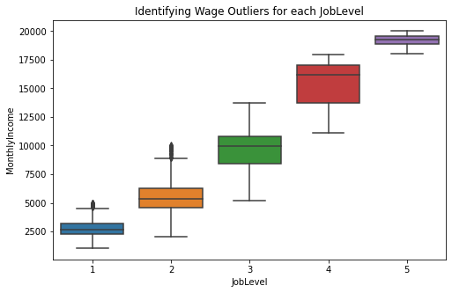
Data Preparation
No null values and erroneous entries found
Remove outliers:
Employees with much higher income but few work experience (see chart)
Removed observations > 1.5 IQR
32 in Level 1, 13 in Level 2.
Generate categorical variables
is_Match
is_NewGrad/is_Junior/is_Senior
Notes:
Outlier:
plot boxplot with job level variable in dataset against monthly income; we noticed observations with much higher monthly income among job level 1 and 2, encompassing Total Work Years from 0 to 20. We then identified 32 entries from JL 1 and 13 from JL that have monthly income greater than 1.5 inter-quartile range and removed from dataset.
Categorical variables generation:
is_match: Each entry comes with employee’s job role as well as their education field. We built a dictionary connecting different roles and the relevant education fields, hence assigning an indicator for each employee. is_Match equals to 1 means a relevant background.
isJunior, Senior: Our team believed that the original job level variable was not accurate enough, as the first level already covered 0-10 working years. We want to make this analysis more relatable for younger employees and students. Thus we generated 3 new tiers of working experience: We define work exp below 2 years as “New Grad”, 2-10 years as “Junior” and those more than 10 years as “Senior”

Slide 7
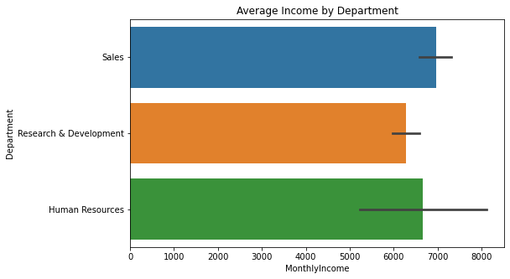
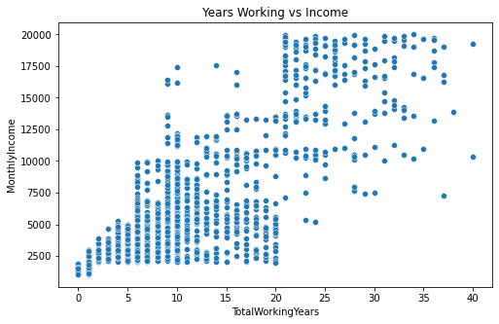
Exploratory Data Analysis
Notes:
These two graphs show the distributions on employees’ monthly income distribution in different departments, and how the total years working experience has impacted on the monthly income.
In terms of monthly income, sales and HR have higher average income compared to R&D department, possibly due to the fact that many lab workers receive low wage. From the scatterplot on the right hand side, we are able to see an overall positive correlation between years working and monthly income. While we also notice a cluster in lower left side with employees of less work experience and lower income.

Slide 8
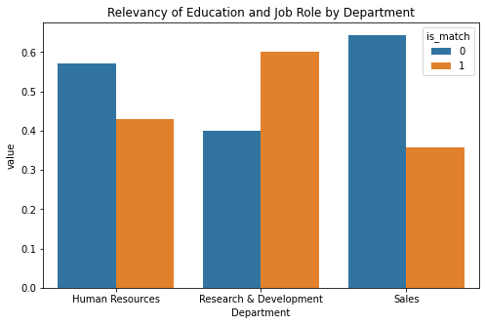
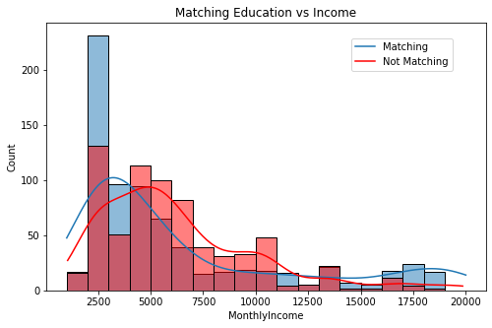
Exploratory Data Analysis
Notes:
These two graphs show the distributions on people have relevant education background in different departments, and how the matching education background has impacted the monthly income.
We notice from the left side that HR and Sales department has a majority of employees without relevant background.
On the right side we have the distribution of income for people with or without relevant education background. Notice that we have a number of employees with relevant education background in the lower end of the distribution.

Slide 9
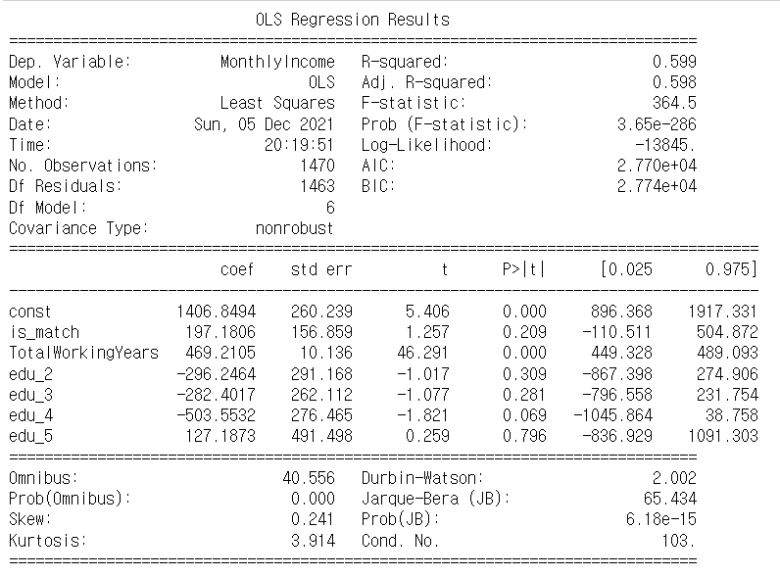
Statistical Analysis (Part1)
Base Model : All employees in every department
We observe that the employees' relevant background is positively correlated with their salary. However, the relationship is not statistically significant.
Counterintuitively, a higher education level is negatively correlated with the salary, though the relationship is also not statistically significant.
Therefore, we will further examine the relationship between different job seniority levels along with the various departments.
Notes:
- (Explanation after second point) A possible explanation for this negative relationship could be due to how specific education levels are expected and valued differently across different job types along with seniority levels.

Slide 10
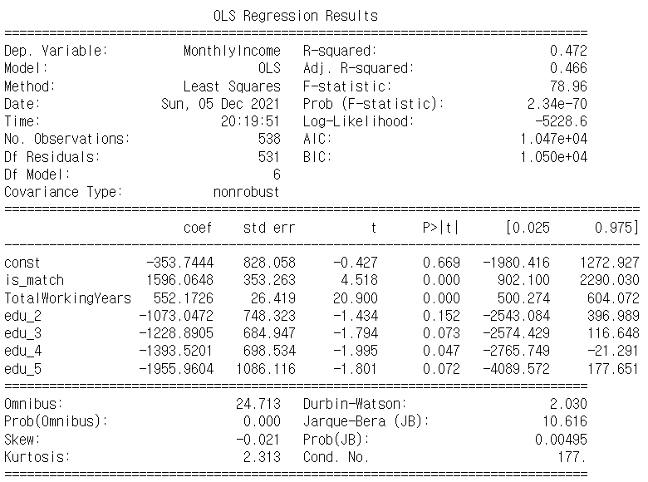
Statistical Analysis (Part2)
Model with job experience level (Senior, 10 < working years)
We observed a statistically significant and positive correlation in between the matched education background and salary
However, the p-value of constant is greater than the significance level at 0.05, we have no sufficient evidence to conclude that the employees who received least education would be significantly correlated with their salary performance
The R-Square has declined in comparison with the previous model, so we need to further explore other segregation models
Notes:
Since the sample scope has changed in this model, and the R-Square has declined in comparison with the previous model, it has further confirmed that we need to further explore other models and relevant factors to draw valid conclusions

Slide 11
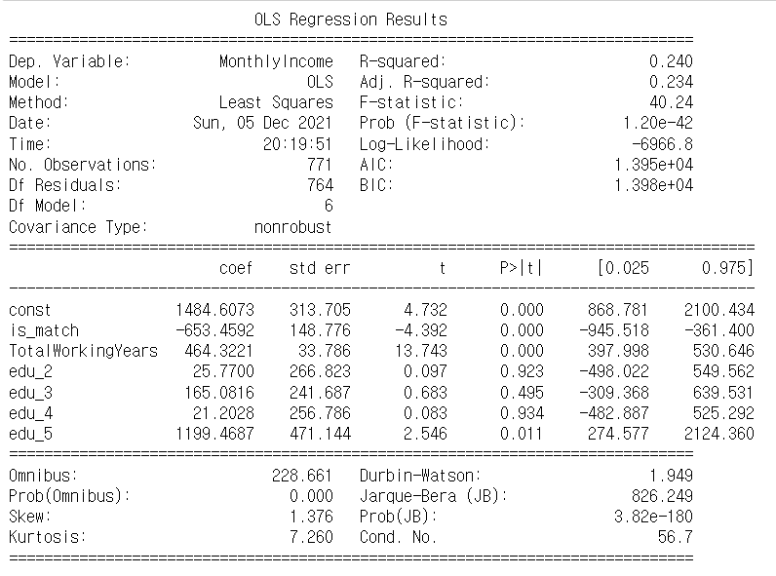
Statistical Analysis (Part2)
Model with job experience level (Junior, 2 < working years <= 10)
The junior level employees who have a base education level and a job-relevant education background have a statistically significant correlation with salary in the model.
The p-values of the junior employees with higher education levels shows insufficient evidence to conclude that those who received advanced education would be significantly correlated with their salary performance except for those with a PhD.
We also note that R-squared has reduced to 0.24, which suggests a possible bias to to a smaller sample size.
Notes:
We found that junior level employees who have a base education level and a job-relevant education background have a statistically significant correlation with salary in the model.
We studied the p-values of the junior employees with higher education levels and found insufficient evidence to conclude that those who received advanced education would be significantly correlated with their salary performance except for those with a PhD.
Even though this model shows that Junior employees with a PhD has a statistically significant correlation with salary, we also note that R-squared has reduced to 0.24, which suggests a possible bias to to a smaller sample size. Hence, we will continue looking at other factors.

Slide 12
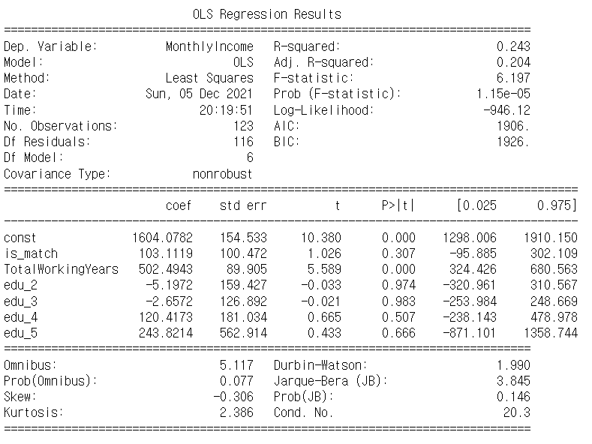
Statistical Analysis (Part2)
Model with job experience level (New grad, working years <= 2)
In this group, the statistical results show neither is_match nor any of the education levels yielded a statistically significant result indicating education's impact on salary.
As a conclusion to the models thus far,
there is no statistically significant coefficient on relevant education background and education levels. The R-squared scores are all lower relative to the base model done on the entire population.

Slide 13

Statistical Analysis (Part3)
Model with different departments (Sales department)
None of the education level and education relevance variables show statistically significance in this model.
Education level as well as the relevancy of the education field have very little explanatory power in terms of understanding the salary of Sales Department employees. This is despite the matching education background and higher education level being associated with a higher salary.

Slide 14
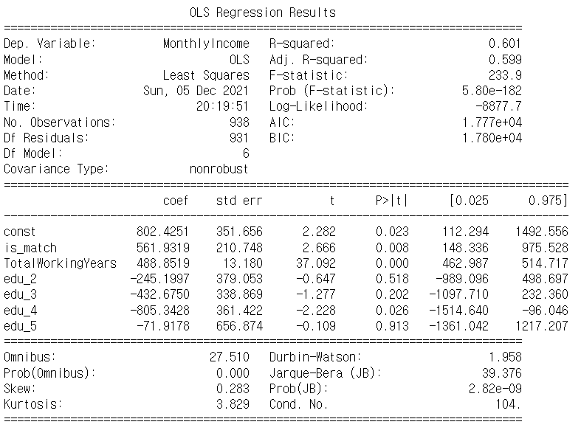
Statistical Analysis (Part3)
Model with different departments (R&D department)
In this group, employees with a base education level and a job-relevant background have a statistically significant positive correlation with salary in this model.
The R&D department consists of roles like Research Scientist, Lab Manager, and Technician. These roles generally require specialized training and domain knowledge, which could explain the increase in salary for those who hold relevant skill sets.
Notes:
(back-up explanation of the first bullet point) A relevant education background results in an average salary increase of $561.93.

Slide 15
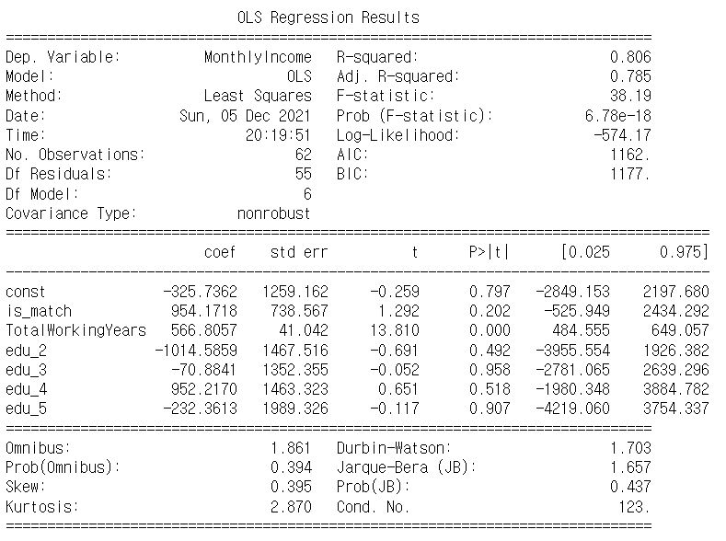
Statistical Analysis (Part3)
Model with different departments (HR department)
Similar to sales department’s findings, a relevant education background or higher education background does not lead to a higher salary for employees in the HR department, as none of the education level and relevance variables show statistical significance in this model.
However, employees’ total working years have the statistically significant relationship with the employees’ salary.
Hence, it is possible to conclude that in the HR department, employees’ salary performance will be more related to their total years of working experience than their advanced education level.

Slide 16
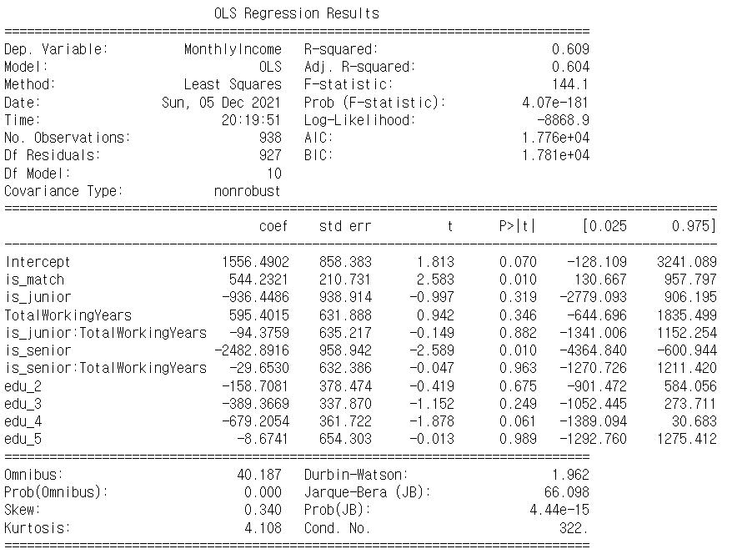
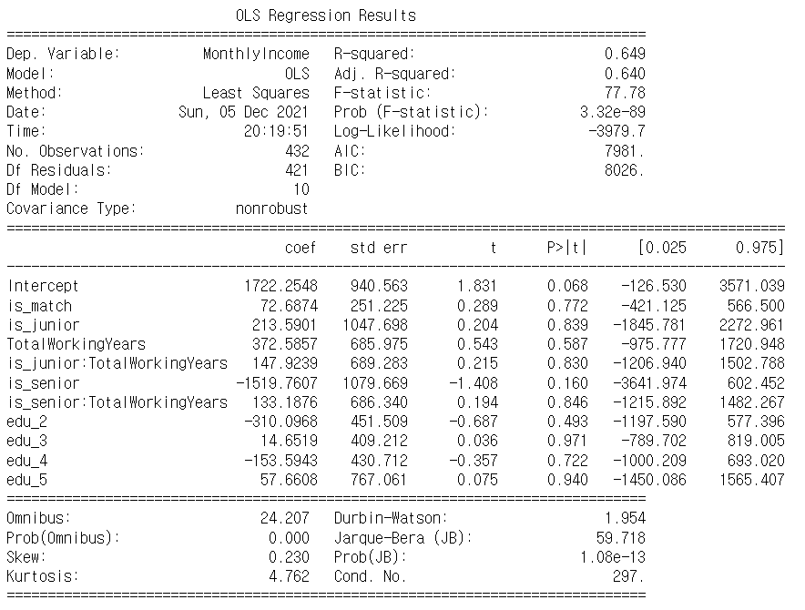
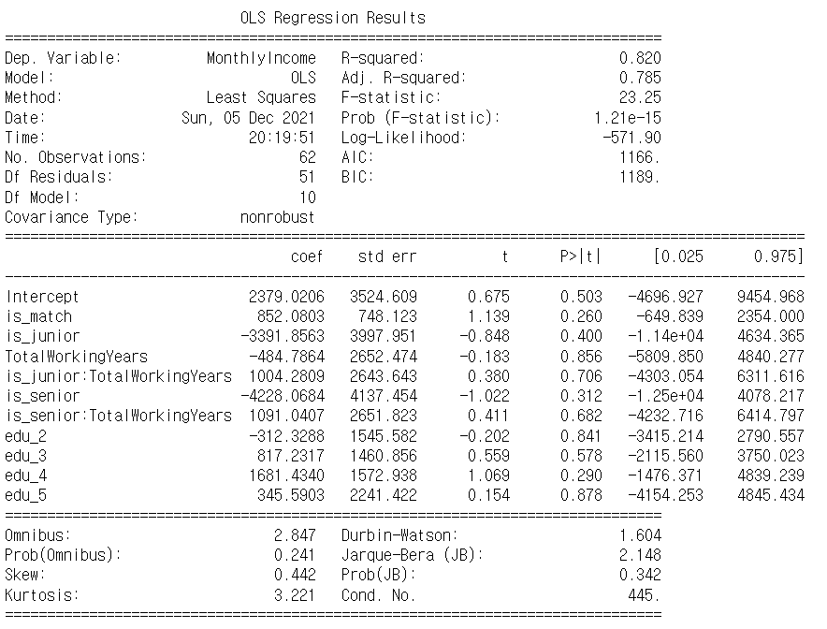
Interaction between work experience level & departments
Notes:
We consolidate the previous two segregation models, and we apply the interaction term in between work experience level and departments into the new model. The purpose of adding the interaction term is to further examine the statistical correlation between work experiences and salary within different departments if the other variable such as education levels are maintain the same.
From the results, the new model with interaction term did not changed our conclusion from the previous models

Slide 17
Key Takeaways and Business Insights
The results challenges our hypothesis:
Education is NOT a good indicator of career success that measured in salary.
Relevance of education background explains the difference in salary at R&D department, but not in Sales and HR departments.
Higher level of education does NOT always increase salary, except for the advanced degree (master’s, PhD’s) holders in more senior-level positions.
Work experience has been a far more significant factor in our model.
It makes us rethink on company’s hiring and human resources development:
Company should weigh education differently in evaluating candidates or employees.
Hiring requirement of education level and background should NOT be generalized but adjusted to the department’s or the role’s need.
On-job training and hands-on learning process is crucial in career development.
Notes:
This results has challenge our previous hypothesis: Education is not a good predictor of salary.
A higher education level does not necessarily link to a higher salary, as we merely observed one positive correlation with senior level employees and this is better explained by how education becomes a key differentiator in deciding salary for this level. Furthermore, junior-level employees with a doctorate degree have a higher average salary. Ultimately, this could be due to the small sample size of employees with a PhD, which amplifies the effect of an advanced academic degree.
Having a relevant education background makes sense when it comes to explaining the salary of R&D employees. The technical and specialized roles within this department generally require expertise within their field.
On the contrary, HR and Sales place more value on work experience, as total working years are more significant predictors of salary. This could be due to the less technical nature of these roles that benefit more from having more years of practical experience.
As for Business implications of our researches:
For company’s hiring or internal evaluation of employees, the impact of education on salary should consider how work experience has a more significant impact on salary along with how different functions of work value education differently.
When making hiring or job promotion decisions, companies should weigh education differently in the evaluation of candidates or employees based on the specific needs of their roles, as we seen from the results in HR and Sales department.
On-job training program and process allowing employees to learn by doing should be encouraged as work experience is the key to career success according to our model.

Slide 18
Reference:
Somers, M.A., Cabus, S.J., Groot, W. and van den Brink, H.M. (2019), Horizontal Mismatch Between Employment And Field Of Education: Evidence From A Systematic Literature Review. Journal of Economic Surveys, 33: 567-603. https://doi.org/10.1111/joes.12271
JAMES C. WITTE, ARNE L. KALLEBERG, Matching Training and Jobs: The Fit Between Vocational Education and Employment in the German Labour Market, European Sociological Review, Volume 11, Issue 3, December 1995, Pages 293–317, https://doi.org/10.1093/oxfordjournals.esr.a036365
Robst, John, (2007), Education and job match: The relatedness of college major and work, Economics of Education Review, 26, issue 4, p. 397-407, https://EconPapers.repec.org/RePEc:eee:ecoedu:v:26:y:2007:i:4:p:397-407.
Maarten H. J. Wolbers, Job Mismatches and their Labour‐Market Effects among School‐Leavers in Europe, European Sociological Review, Volume 19, Issue 3, 1 July 2003, Pages 249–266, https://doi.org/10.1093/esr/19.3.249
Anthony P. Carnevale, Ban Cheah, and Emma Wenzinger. The College Payoff: More Education Doesn’t Always Mean More Earnings. Washington, DC: Georgetown University Center on Education and the Workforce, 2021. https://cew.georgetown.edu/cew-reports/collegepayoff2021/#resources

